Slide 1
PSYC 121, Week 3
Variability and z-scores

Slide 2
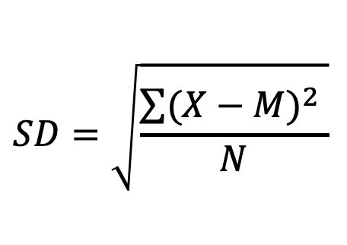
The standard deviation
Standard deviation describes the spread of a group of scores
It is (roughly) the average amount that scores differ from the mean
$$SD=\sqrt{\frac{\sum{{(X−M)}^{2} }}{N}}$$

Slide 3
Learning outcomes
By the end of the lecture you should be able to:
  Understand what a normal distribution involves
  Understand the relationship between standard deviation and z-scores
  Translate between z-scores and probabilities

Slide 4
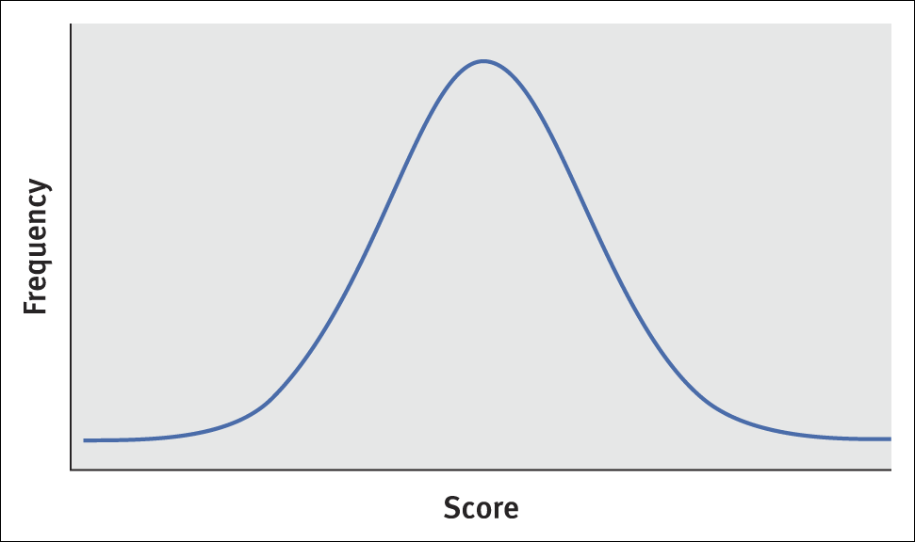
Properties of the normal curve
When we examine variability, as a distribution of events (scores, frequencies etc.) we often find that we produce a normal distribution of scores Normal distribution curves are bell-shaped
  They are bilaterally symmetrical
  The tails of the curve approach, but do not touch, the X-axis.
  Although the graph will go on indefinitely, the area under the graph is considered to have a unit of 1.00
  The mean, median, and mode are the same value
  (You can estimate the mode and median by simply looking at a graph: the mode is the value with the highest frequency, and the median is the middle point. It is harder to estimate the mean, however, as that depends on the range of values. Unless it is a normal distribution!)

Slide 5
The importance of the normal distribution curve
Many of the variables in behavioural sciences closely approximate the normal curve.
Many inference tests require sampling distributions that are normally distributed.

Slide 6
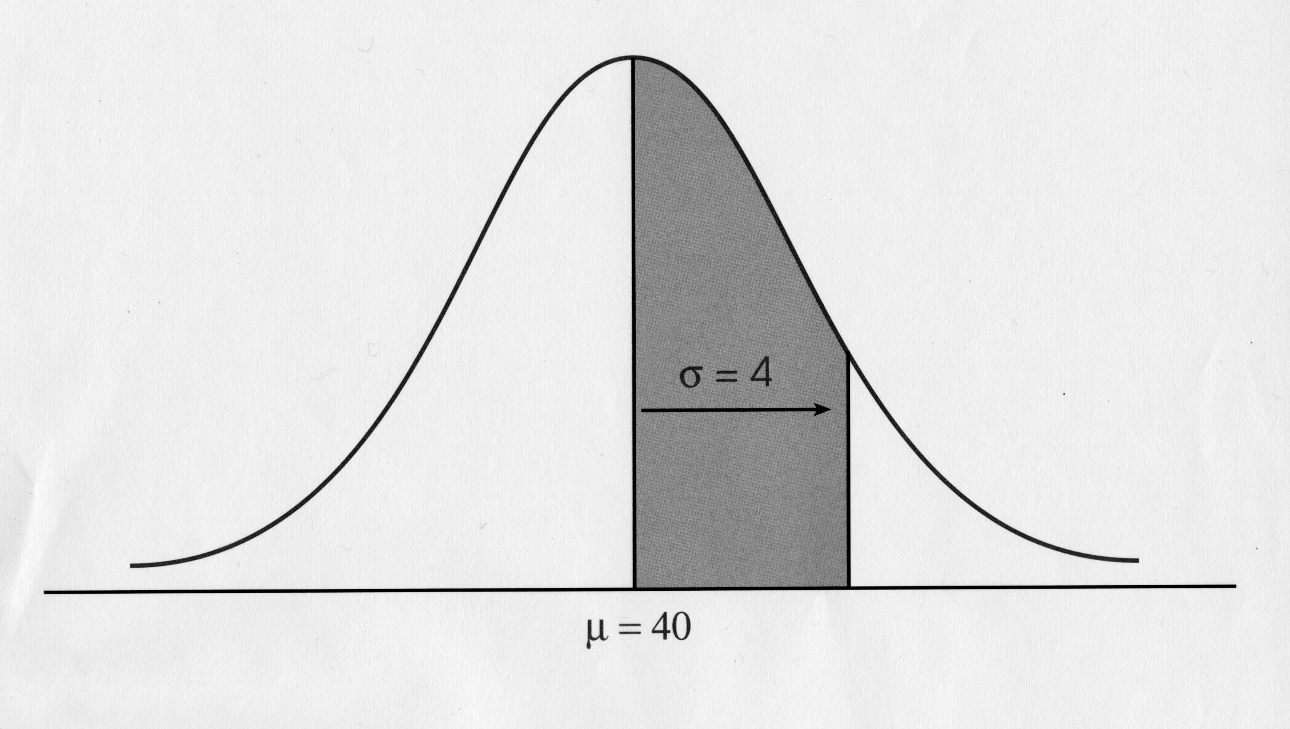
Properties of the normal distribution
SD=4
M=40

Slide 7
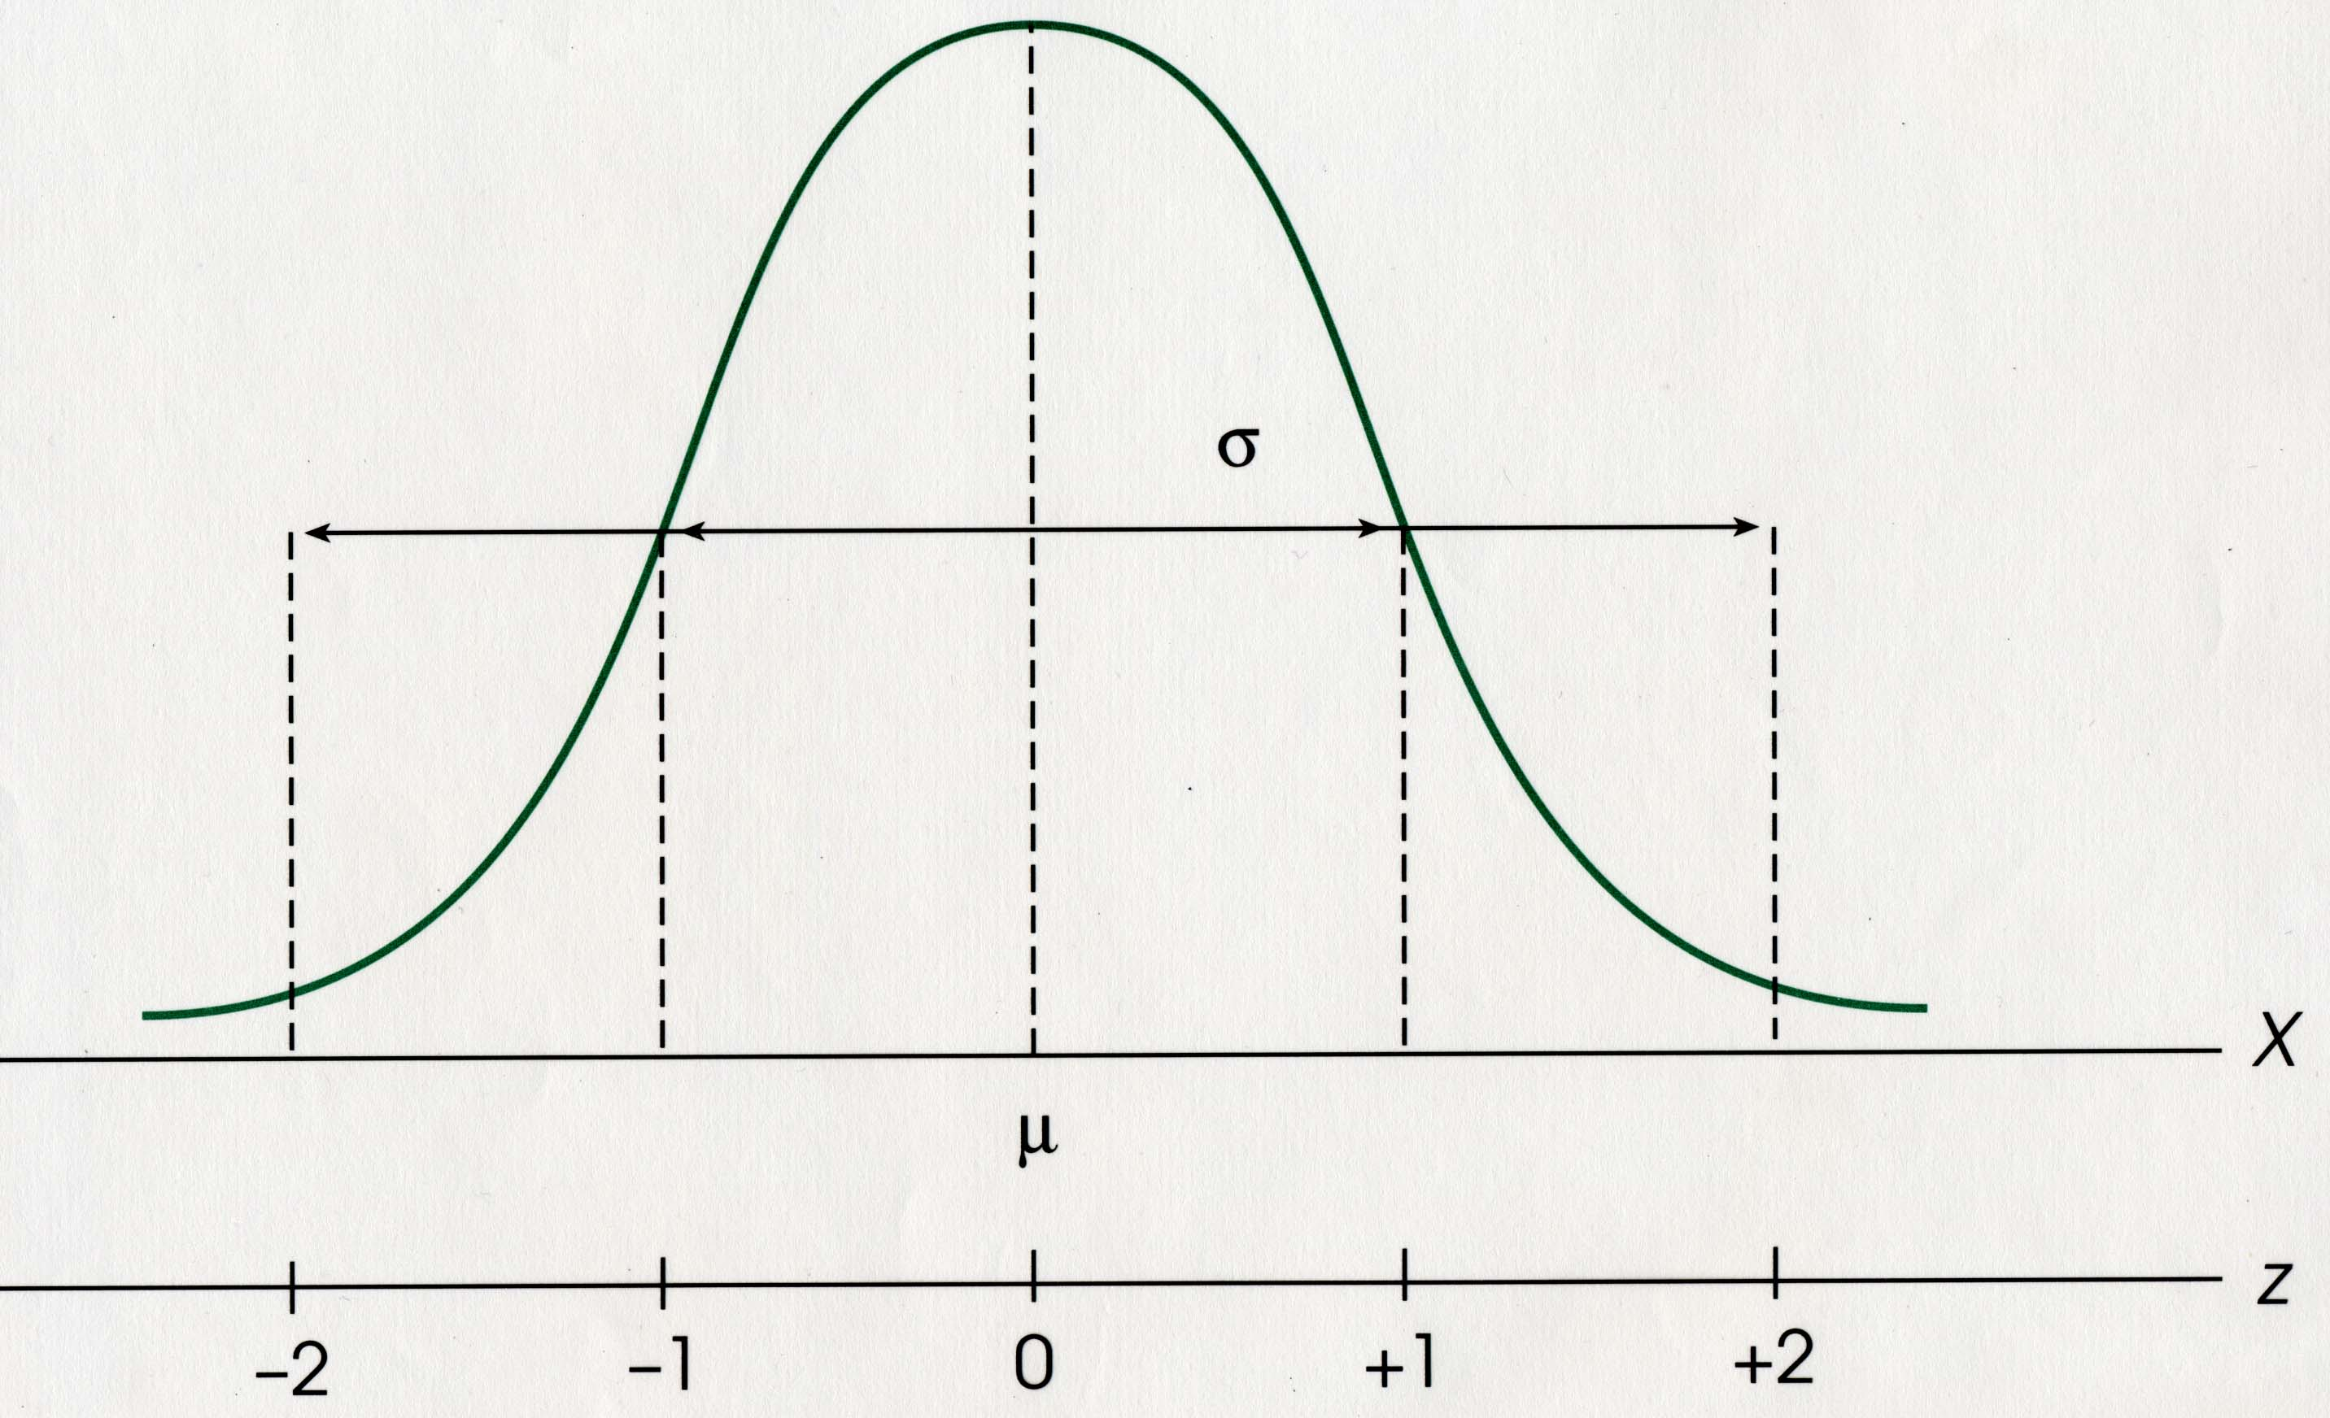
Properties of a normal distribution
The further away from the mean, the less likely an event is
SD
M

Slide 8
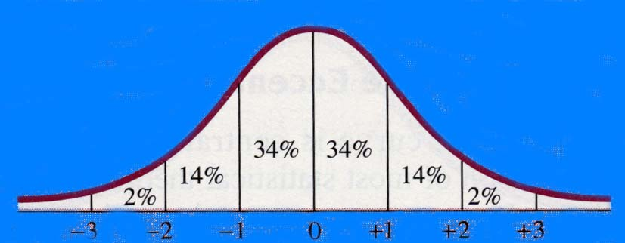
Places along the normal distribution
We know the percentage of scores that lie within areas of the normal curve (approximate numbers shown here)
We can use information about variability to establish where in a distribution a point lies.
We can derive probabilities associated with points in the distribution

Slide 9
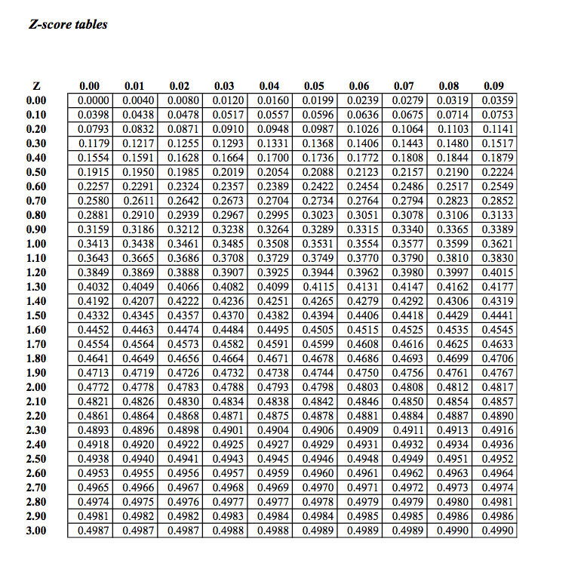
Exact places along a distribution

Slide 10
Exact places along a distribution

Slide 11
Exact places along a distribution

Slide 12
Z-score distribution
Z scores provide a nifty way to identify where a score lies relative to distribution of values.
Do you spend a lot of money on clothes?
An informative (if sad!) answer would be in terms of a z-score.
  The sign of a z-score indicates whether is it above or below the mean.
  The value of a z-score indicates the distance from the mean in term of the number of standard deviations

Slide 13
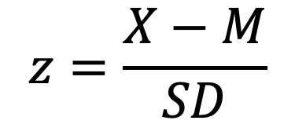

Formulae
Mean
Standard deviation
To find z:
$$z=\frac{X−M}{SD}$$
To find X:
$$X=z\left(SD\right)+M$$

Slide 14
An example of using z scores
Bob gets a score of 60 on a psychology exam
He also gets a score of 56 on a biology exam.
Which is the better performance?
For psychology, M = 50, SD= 10
For biology, M = 48, SD= 4
For psychology, z = +1.0
For biology, z = +2.0

Slide 15
Calculations with the Normal Distribution
Questions such as “How many people get a score between 34 and 64 on a test where the mean is 44 and SD=5?”
Steps for estimating percentage area above or below particular raw or z-score:
  1. Convert raw score to z-score (if necessary)
  2. Draw normal curve, locate where z-score falls on it, and shade in area for which finding percentage
  3. Make rough estimate of shaded area’s percentage (using 50%-34%-14% rule)
Notes:
A test has a mean of 100 and SD of 15.
What percentage of scores will be greater than 123?
Mark gets a score of z=-.5. What is his relative performance?

Slide 16
The Normal Distribution
Steps for calculating percentage area above or below particular raw or z-score:
Determine exact percentage using normal curve table
If needed, add or subtract 50% from this percentage
Check that exact percentage is within range of estimate

Slide 17
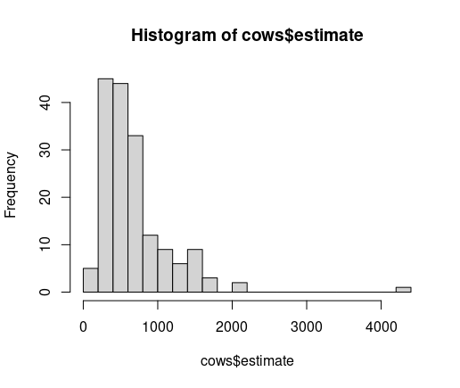
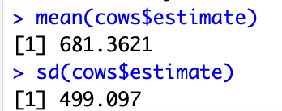
Data examples
Weight estimates for Penelope the cow

Slide 18
Distribution of data from PSYC121 2021 students
From a Maths screening exercise

Slide 19
Z-scores and a maths screen
One person (“Cyril”) gets a score of 90%
Mean = 83.9
SD=15.3
Assume scores were normally distributed
Cyril z-score = .40 (.39869)
  65.54% of scores are lower than this
  34.46% of scores are higher than this

Slide 20
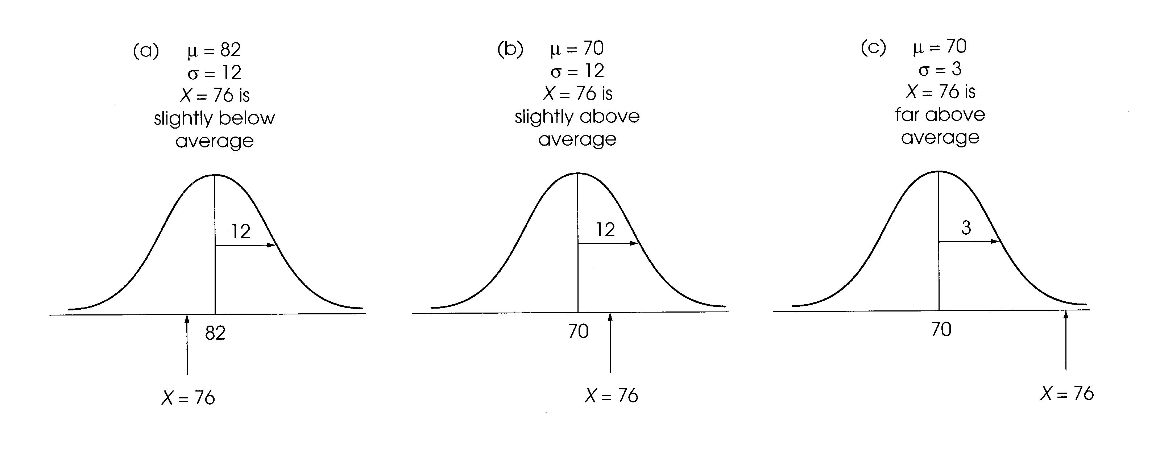
Z score distribution
A score can lie in different relative positions on a normal distribution, depending on the variability.

Slide 21
Summary
We need to be comfortable with notions of central tendency and variability to understand many psychological phenomena
The normal distribution is important for thinking about how to interpret descriptive data
z-scores help to describe locations in a distribution
Large z-scores represent unusual or extreme outcomes

Slide 22
To think about next week
Consolidate z-scores
Calculate regions of the curve
Hypothesis testing (inferential tests not just descriptive)

